Slide 1

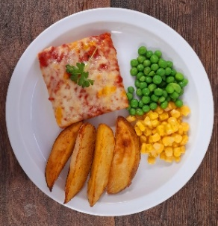
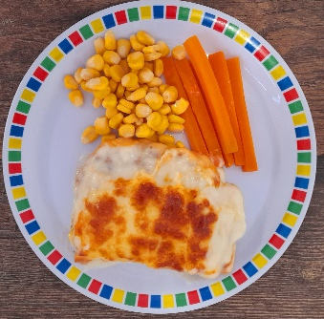
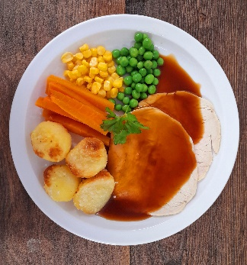
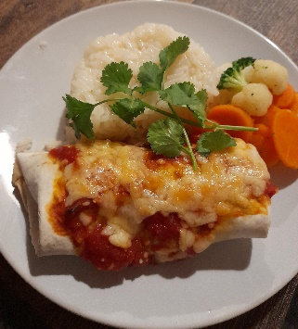
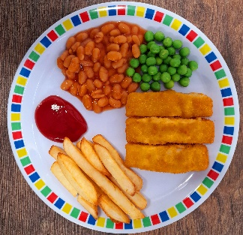
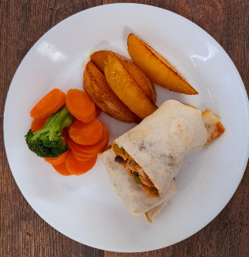
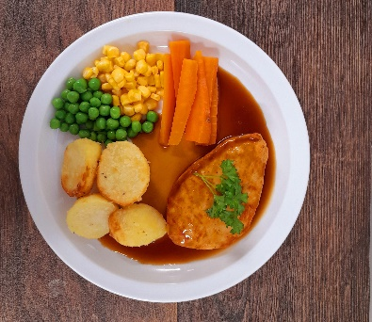
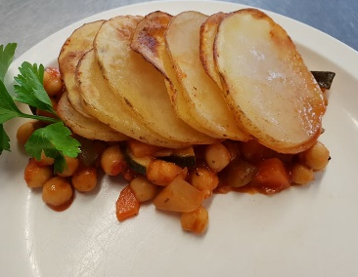
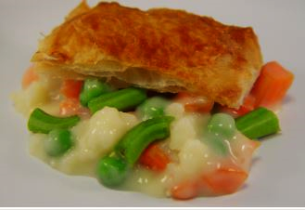
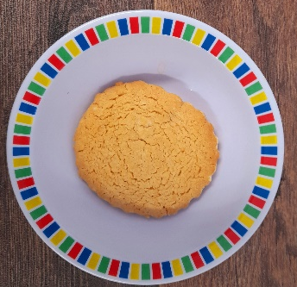
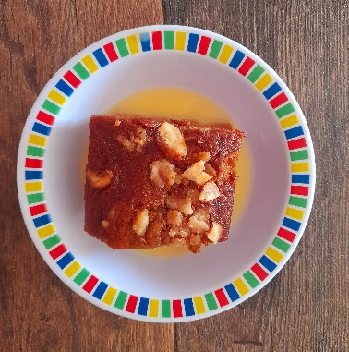
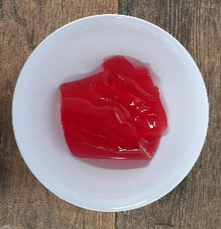
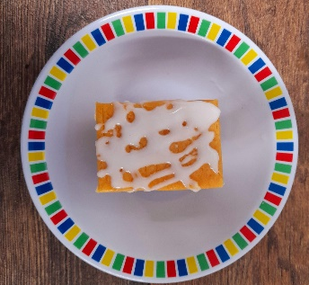

Proposed Spring Summer 20223 Picture Menu
 |  | Monday | Tuesday | Wednesday | Thursday | Friday
Week One 02/01/23 23/01/23 13/02/23 13/03/23 | Option 1 | Cheese & Tomato Pizza with Wedges | Beef Lasagne with Garlic Bread | Roast of the Day, Roast Potatoes & Gravy | Chicken Enchiladas with Rice | Fishfingers with Chips & Tomato Sauce
 | Option 2 | Vegetable & Bean Fajitas with Rice | Creamy Vegetable Pie with New Potatoes | Vegan Quorn with Stuffing, Roast Potatoes & Gravy | Vegetable Hotpot with Rice | Mexican Bean Roll with Chips & Tomato Sauce
 | Dessert | NEW Syrup Snap Biscuit | Eves Pudding With Custard | Fruit Jelly with Mandarins | Vanilla Sponge with Custard | Oaty Cookie
*Vegetables & Carbohydrates may differ than those shown

Slide 2
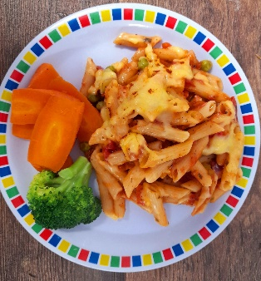
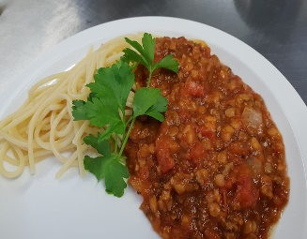
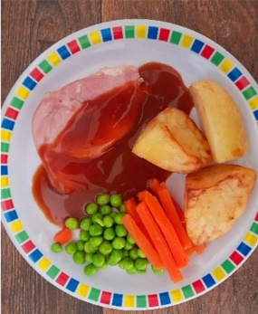
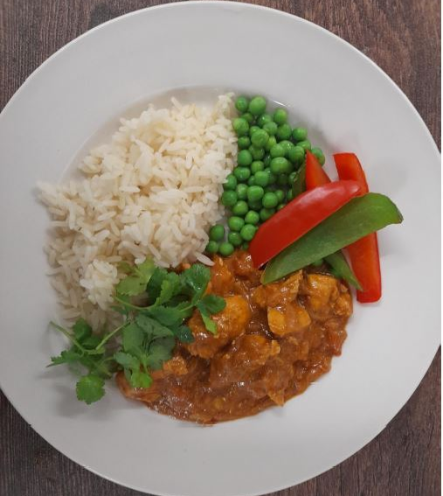
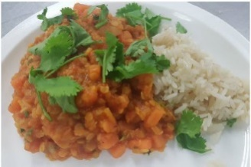
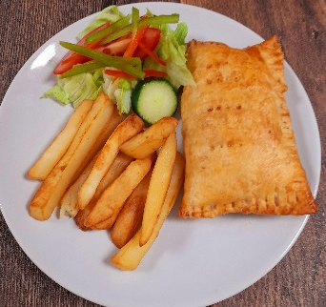
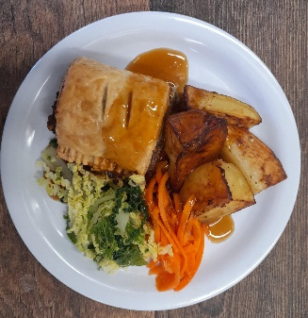
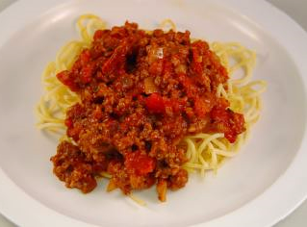
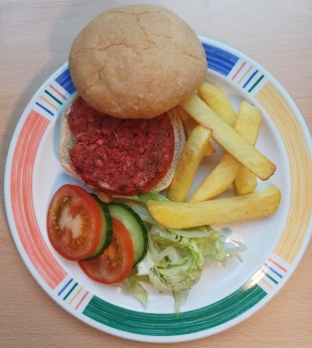
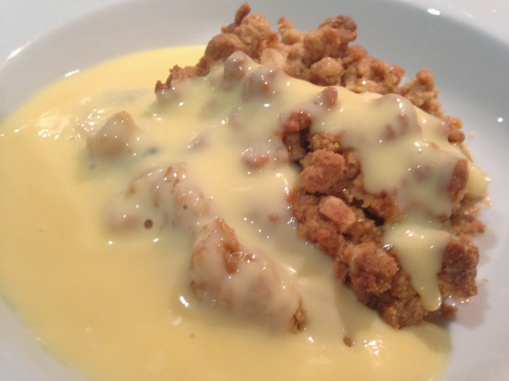
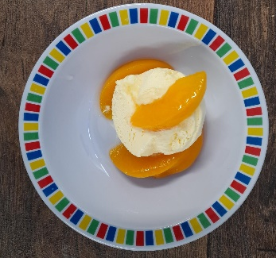
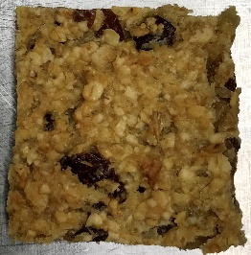
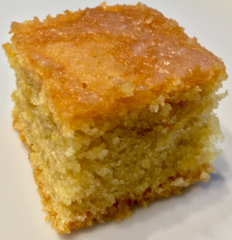

Proposed Spring Summer 20223 Picture Menu
 |  | Monday | Tuesday | Wednesday | Thursday | Friday
Week Two 02/01/23 23/01/23 13/02/23 13/03/23 | Option 1 | Vegetable Pasta Bake | Spaghetti Bolognaise | Roast of the Day, Roast Potatoes, Stuffing & Gravy | Chef’s Special Chicken Korma with Rice | Fishfingers or Salmon Fishfingers with Chips & Tomato Sauce
 | Option 2 | Sweet Potato Curry with Rice | Cheesy Bean Pasty with Cajun Wedges | Vegetable Wellington with New Potatoes & Gravy | Vegan Spaghetti Bolognaise | NEW Beetroot Burger with Chips
 | Dessert | Orange Drizzle Cake | Sticky Toffee Apple Crumble with Custard | Peaches and Ice Cream | Apple Flapjack | Vanilla Shortbread
*Vegetables & Carbohydrates may differ than those shown

Slide 3

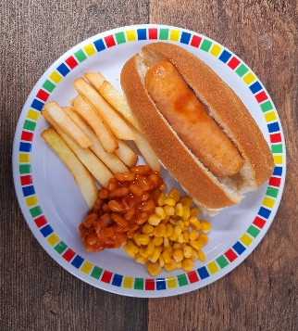
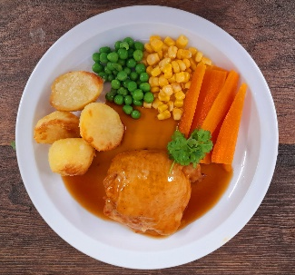
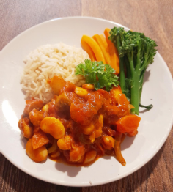
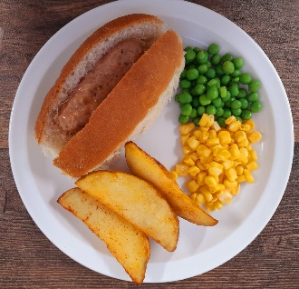
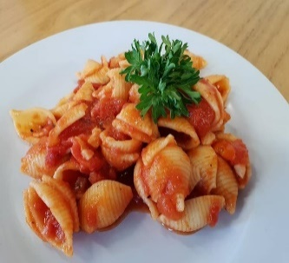
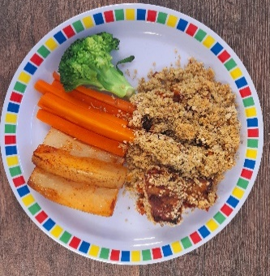
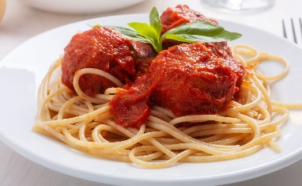
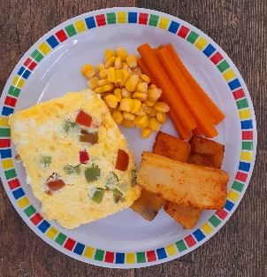

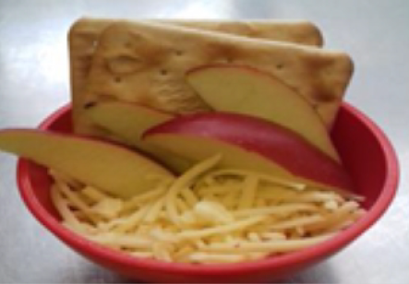

Proposed Spring Summer 20223 Picture Menu
 |  | Monday | Tuesday | Wednesday | Thursday | Friday
Week Three 16/01/23 06/02/23 06/03/23 27/03/23 | Option 1 | Macaroni Cheese | Spaghetti Bolognaise | Roast of the Day, Roast Potatoes, Stuffing & Gravy | Chicken Casserole with Rice | Fishfingers with Chips & Tomato Sauce
 | Option 2 | Vegetable Hot Dog with Potato Wedges | Vegetable Pasta Bake | Vegetable Gratin with Roast Potatoes & Gravy | Vegetable Meatballs in Tomato Sauce with Pasta | Cheese & Red Pepper Frittata with Chips & Tomato Sauce
 | Dessert | Orange & Lemon Shortbread | Carrot & Courgette Cake with Custard | Apple, Cheese and Crackers | Mixed Fruit Crumble with Custard | Chocolate Shortbread
*Vegetables & Carbohydrates may differ than those shown

