Slide 1
GIVE/KINDNESS
With in this power point you will be learning about giving kindness…

Slide 2
To give kindness to someone you could give people really nice complements about them, or share lots of your knowledge to others and they share there's with you. Sometimes some people feel lonely and sad so they sit on the buddy bench to see if anyone would come to play with them and you would go up to them to ask if they would like to play.

Slide 3
How to charm your stress.
If you feel real tense and you want to take it away you would find a place alone and do this:
Place your finger on the top off your head and slowly drag your finger all of the way down to your chin. This will help you feel charm and very relaxed and also there is this breath in out thing .So you breath in for 4 seconds and then breath out slowly for another 6 seconds ,then do it again this is also to release all of that stress ready for you to go and play some more.

Slide 4
As we have been doing this thing called operation Christmas child it would be the best thing to do for kindness because you are sending presents to the people who have nothing.
presents
To you
Look inside
you

Slide 5
Help the elderly
If you see an elderly person is lonely, you should go to them to talk and give them lots of company. Also you could go to a local old peoples homes and talk to them to have giggles and be nice ,this is also other ways to be kind to people.

Slide 6
ideas
Make lots of posters about kindness to put around the school
Helping the new
Give time to others
Give nice complements
Stand up for other people
Manners
Having class buddies
Share knowledge
Share things in the class room
Smile= to make someone's day happy

Slide 7
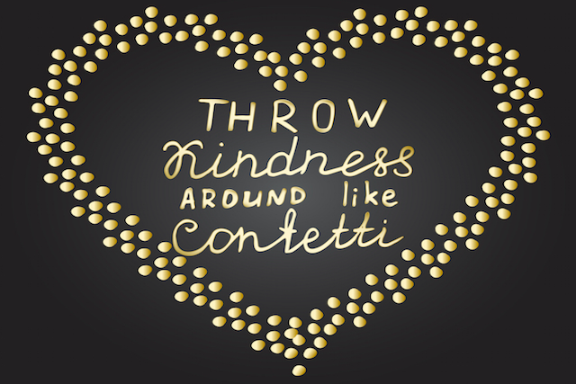

Slide 8
☺☺☺
Thankyou for listening

